Slide 1

Title IX Overview for Administrators (Coordinators and Decision-Makers)
Atlanta Public Schools

Slide 2
Content Notice
The content and discussion in this training will necessarily engage with sex- and gender-based harassment, discrimination, violence, and associated sensitive topics that can evoke strong emotional responses.
During this training, we may offer examples that emulate the language and vocabulary that Title IX practitioners (you!) may encounter in your roles including slang, profanity, and other graphic or offensive language. It is not used gratuitously, and no offense is intended.

Slide 3

Title IX: A Primer

Slide 4
What is Title IX?
Title IX of the Education Amendments of 1972
Protects people from discrimination based on sex in education programs or activities that receive federal financial assistance.
Enforced by the Office of Civil Rights (“OCR”).
Protects all persons from discrimination, including parents and guardians, students, and employees.
What does Title IX say?
No person in the United States shall, on the basis of sex, be excluded from participation in, be denied the benefits of, or be subjected to discrimination under any education program or activity receiving Federal financial assistance.

Slide 5

Doesn’t Title IX Only Apply to Athletics?
NO!
Title IX also applies to:
Recruitment, admissions and counseling
Sex based harassment
Treatment of pregnant and parenting students
Discipline
Single sex education
Employment matters

Slide 6
Pregnancy or Parental Status
Title IX prohibits a school from discriminating against a student based on the student’s:
Pregnancy
Childbirth
False pregnancy
Termination of pregnancy
Recovery from any of these conditions.
Title IX also prohibits a school from applying any rule related to a student’s parental, family, or marital status that treats students differently based on their sex.

Slide 7

Title IX in Athletics
School districts must provide equal athletic opportunities for both sexes.
OCR considers whether an institution is effectively accommodating the athletic interests and abilities of students of both sexes.
Factors that are considered by OCR:
Equipment and supplies;
Game and practice times;
Travel and per diem allowances;
Coaching and academic tutoring;
Assignment and compensation of coaches and tutors;
Locker rooms, practice and competitive facilities;
Medical and training facilities and services;
Housing and dining facilities and services; and
Publicity.

Slide 8

Other Examples of Title IX Issues
Discrimination in student discipline
Unequal access to educational resources
STEM opportunities / programs
Career / technical education

Slide 9

Statutory and Regulatory Changes

Slide 10

Recent Changes to Title IX Regulations
OCR amended Title IX Regulations in 2020, focusing on those provisions pertaining to sexual harassment.
Subsequent 2024 regulatory amendments, currently enjoined (blocked) statewide in Georgia.
This presentation will focus on Title IX obligations and requirements that are relevant to K12 school districts.

Slide 11
Title IX Policies and Procedures
Atlanta Public Schools has its own comprehensive Title IX policies and procedures.
They are periodically updated to comply with applicable Title IX Regulations, but should be each employee’s starting point with respect to Title IX matters.
The District’s Title IX Coordinator and Title IX staff are valuable resources for school-level administrators as they receive complaints, investigate allegations, and make determinations regarding responsibility.
Make sure you are familiar with Board policies associated with Title IX, discrimination, harassment, grievance procedures – available on District website.

Slide 12

Student-on-Student Sexual Misconduct
According to data from the U.S. Department of Education’s Office for Civil Rights, there were 14,938 incidents of sexual violence in K–12 schools in 2017 – 2018 compared with 9,649 in 2015 – 2016, representing a 55 percent increase.
According to a 2019 report from the National Center for Educational Statistics, the number of reported forcible sex offenses on school campuses increased from 2,200 in 2001 to 10,400 in 2017 (a 372 percent increase).
Both the 2015 – 2016 Civil Rights Data Collection and the Data Highlight on School Climate and Safety published in 2018 indicated that students reported approximately 9,700 incidents of sexual assault, rape, or attempted rape at elementary and secondary schools in the 2015 to 2016 academic year.
Research from Hofstra University found that roughly 1 in 10 students in K-12 schools have suffered “some form of sexual misconduct by an educator,” but student-on-student sexual misconduct continues to be a matter of great concern to the District.

Slide 13

Student-on-Student Sexual Misconduct: Prevention
Create a culture of consent.
Partner with parents and other trusted adults in students’ lives.
Share age-appropriate resources for education.
Monitor high-risk areas or activities (but know that sexual misconduct or abuse can and does take place in areas that may not be deemed “high risk”).
Dispel common sexual misconduct myths and misconceptions.

Slide 14

Student-on-Student Sexual Misconduct: Identification
Student-on-student sexual misconduct can take many forms. Misconduct might include, but is not limited to:
Title IX specific offenses, hostile environment, or quid pro quo;
Dating or relationship violence;
Transmitting sexually explicit images, photos, videos or any other media without the consent of the recipient and all involved parties;
Soliciting or promoting sexual performance using minors;
Inappropriate touching of private body parts;
Invasions of privacy;
Sexual exploitation;
Other inappropriate behaviors of a sexual nature.
If you see (or hear or otherwise become aware of) something, make a report to the Title IX Office!

Slide 15

Student-on-Student Sexual Misconduct: Identification
Non-exhaustive behaviors to look out for:
Ducking behind desks, lab benches, gym mats, or using other methods to avoid detection;
Shushing or motioning for other students to be quiet so as not to draw attention;
Removal or alteration of clothing;
Inappropriate physical contact with others or with oneself;
Fear of physical contact;
Emotional manipulation or assertion of pressure;
Excitement surrounding a cell phone or mobile device;
Unwelcome touching, pinching, or restraining of students by another student;
Catcalling or suggestive comments;
Obscene gestures;
Refusal to sit next to or near another student;
Behavioral changes.

Slide 16
Student-on-Student Sexual Misconduct: Reporting
If you see or hear or are told about something, say something.
ALL allegations of conduct that MIGHT qualify as sex discrimination—in any form—MUST be reported TO THE TITLE IX COORDINATOR as quickly as possible.
APS’s Title IX Coordinator is Felisha Jackson. She can be reached at Felisha.jackson@atlanta.k12.ga.us.

Slide 17
Student-on-Student Sexual Misconduct: Investigation
Must be adequate, reliable, and impartial.
Burden on the assigned Title IX investigator to conduct the investigation and gather evidence.
Equal opportunity to be accompanied by an advisor (which can be, but isn’t required to be, an attorney).
Parties must have equal opportunity to present fact and expert witnesses, inculpatory & exculpatory evidence that is relevant and permissible.
Determine what evidence is relevant and what evidence is impermissible even if it’s relevant.
Provide equal opportunity to access relevant and not otherwise impermissible evidence: investigative report and evidence inspection (10 day timeline).
Take reasonable steps to prevent and address unauthorized disclosure.
Notes:
After you report an incident of observed or suspected sexual misconduct to the Title IX Coordinator, the District will conduct an investigation. You may be asked questions as part of that investigation and should cooperate fully with the District during this process.
Here are the nuts and bolts of the 2024 (and sometimes 2020) Regulations’ requirements for the mechanics of an investigation. The overarching goal is to gather the facts and present them, along with the relevant and permissible evidence, to the Decision-Maker.

Slide 18
Student-on-Student Sexual Misconduct: Resolution
Standard of Proof: Preponderance of the evidence.
“More likely than not” that the conduct occurred.
“50% and a feather”
If the Decision-Maker is not persuaded under that standard by the evidence that sex discrimination occurred, whatever the quantity of the evidence is, the Decision-Maker must not determine that sex discrimination occurred.
Under both the 2020 and 2024 Regs the District is not required to hold a live hearing.
Determination must be issued in writing and must include:
The rationale for the determination, and
The procedures and bases for appeal.
Title IX Coordinator must coordinate provision and implementation of remedies and sanctions.
Notes:
After you report an incident of observed or suspected sexual misconduct to the Title IX Coordinator, the District will conduct an investigation. You may be asked questions as part of that investigation and should cooperate fully with the District during this process.
Here are the nuts and bolts of the 2024 (and sometimes 2020) Regulations’ requirements for the mechanics of an investigation. The overarching goal is to gather the facts and present them, along with the relevant and permissible evidence, to the Decision-Maker.

Slide 19
Students With Disabilities: Additional Considerations
Students with disabilities may be at an increased risk of experiencing sex discrimination or sex-based harassment, due in part to:
Communication barriers that prevent giving consent and disclosing abuse;
Potential decreased capacity to consent to sexual activity;
Limited sexual education and knowledge;
Increased personal care needs requiring close contact.
Students traveling on Special Education busses or in in Special Education classrooms are not inherently or automatically safer than those students on General Education busses or in General Education classrooms.
Notes:
This list of risk factors is not exhaustive, but evidence does suggest that children with intellectual and/or developmental disabilities are at a higher risk for sexual abuse and victimization than their non-disabled peers.

Slide 20
Consent Considerations
The Assistant Secretary [OCR] will not require recipients [schools] to adopt a particular definition of consent with respect to sexual assault, as referenced in this section [the 2020 Title IX Regulations].
Educating students about consent:
For students:
Consent means that you agree to something. You say YES. But consent isn’t just saying YES.
We need our consent to be “informed.” Informed consent means that when you say YES, you understand exactly what you are agreeing to and what the results may be.
Your body belongs to you, and someone needs to ask to get consent from you before touching you. Remember, “My body belongs to me.”
You can say NO to someone touching you, or say YES to one thing (hugging) and NO to another (kissing).
You must also get consent from other people before you touch them. The other person must say YES.

Slide 21
Consent Considerations and Intersection with Students with Disabilities
When considering whether or not a student consented, their special education status/disability needs to be considered.
Non-verbal students may have trouble giving or communicating consent.
Students with severe intellectual disabilities cannot provide informed consent to sexual activity.
Consent cannot and should not be assumed, particularly in the case of students with disabilities. Not all disabilities are visible, and cognitive disabilities may prevent students who physically or developmentally resemble their peers from fully understanding their conduct or its consequences.

Slide 22
Title IX Life Cycle
Receipt of Complaint
Report to Title IX Coordinator
Intake & Evaluation
Investigation
Determination Regarding Responsibility
Appeal
Notes:
This is just an overview slide, and it’s pretty simplified for ease of reference. We wanted to give you an idea of how the pieces fit together. Forests and trees and whatnot.
You should be generally familiar with this process and with how your roles fit into it.

Slide 23

Title IX Coordinator: Captain of the Ship
Overarching role: Coordinate the District’s efforts to comply with its responsibilities under Title IX.
Contact information must be prominently displayed (name, title, office, email, phone).
Any person may report sex discrimination in person, by mail, by telephone, by electronic mail, or by other means. Reports may be made at any time.

Slide 24
Clear Division of Labor
Title IX Coordinator:
Coordinates the District’s response to allegations of sex discrimination; interfaces with Complainants and Respondents to advise them of their rights and shepherd the process.
1
Title IX Investigator:
Conducts a fair, neutral, impartial fact-finding investigation into allegations of sex discrimination, culminating in an objective investigation report.
2
Title IX Decision-Maker:
Utilizes the “preponderance of the evidence” standard to make determinations regarding responsibility and, if appropriate, to impose disciplinary sanctions.
3

Slide 25
Sexual Harassment
If a school district has actual knowledge of sexual harassment in an education program or activity of the school district against a person in the United States, it must respond promptly in a manner that is not deliberately indifferent.

Slide 26
“Actual Knowledge”
“Actual knowledge” means notice of sexual harassment or allegations of sexual harassment to a recipient’s Title IX Coordinator or any official of the recipient who has authority to institute corrective measures on behalf of the recipient or to any employee of an elementary and secondary school.
Administrators
Teaching staff
Clerical staff
Custodial and food service staff
Transportation staff
YOU!!

Slide 27

“Education Program or Activity of School District”
What is “an education program or activity of the school district”?
Any location, event, or circumstance over which the school district exhibits substantial control over both the alleged harasser and the context in which the harassment occurred.
Title IX does not impose a duty to report purely off-campus conduct.

Slide 28

“Education Program or Activity of School District”
If conduct occurs in a building owned or controlled by a student organization that is officially recognized by the District, this qualifies as an “activity of the school district.”
If conduct occurs on an international field trip or at any location outside the United States, it is excluded from this definition.
What about sexual misconduct that occurred off-campus but has an out-campus effect?
This falls outside the DOE’s jurisdictional requirements and would be addressed through other District policies.

Slide 29
“Deliberate Indifference”
A school district is “deliberately indifferent” if its response to sexual harassment is clearly unreasonable in light of the known circumstances.

Slide 30
Three Categories of Sexual Harassment
There are three categories that meet OCR’s definition of sexual harassment and must be reported
Quid pro quo
Sexual assault, dating violence, domestic violence, stalking
“Unwelcome conduct determined by a reasonable person to be so severe, pervasive, and objectively offensive that it effectively denies a person equal access to the recipient’s education program or activity”
Remember, though, that ALL incidents of sexual misconduct—even misconduct that doesn’t fall into the above categories—should be reported promptly to your supervisor and to the Title IX office for review.

Slide 31
Sexual Harassment: Category 1
“Quid pro quo”
If an employee of the school district conditions the provision of an aid, benefit, or service of the school district on an individual’s participation in unwelcome sexual conduct, this is sexual harassment.
This conduct must be reported.

Slide 32
Sexual Harassment: Category 2
“Sexual assault” as defined in 20 U.S.C. § 1092(f)(6)(A)(v)
“Dating violence” as defined in 34 U.S.C. § 12291(a)(10)
“Domestic violence” as defined in 34 U.S.C. § 12291(a)(8)
“Stalking” as defined in 34 U.S.C. § 12291(a)(30)
Conduct that falls within any of these definitions must be reported.

Slide 33
Sexual Harassment: Category 3
“Unwelcome conduct determined by a reasonable person to be so severe, pervasive, and objectively offensive that it effectively denies a person equal access to the recipient’s education program or activity.”
This conduct must be reported.

Slide 34
2020 Title IX Process: Requires Formal Complaint
Formal complaint means a document filed by a complainant or signed by the Title IX Coordinator alleging sexual harassment against a respondent and requesting that the recipient investigate the allegation of sexual harassment.
At the time of filing a formal complaint, a complainant must be participating in or attempting to participate in the education program or activity of the recipient with which the formal complaint is filed.
A formal complaint may be filed with the Title IX Coordinator in person, by mail, or by electronic mail, by using the contact information required to be listed for the Title IX Coordinator, and by any additional method designated by the recipient.
Where the Title IX Coordinator signs a formal complaint, the Title IX Coordinator is not a complainant or otherwise a party.

Slide 35
What Happens After Report of Sexual Harassment
Upon a report or formal complaint of sexual harassment, a school district must treat complainants and respondents equitably by offering supportive measures to both and following a grievance process before disciplining/sanctioning respondents.
Complainant means an individual who is alleged to be the victim of conduct that could constitute sexual harassment.
Respondent means a person who has been reported to be a perpetrator of conduct that could constitute sexual harassment.

Slide 36
“Supportive Measures”
Non-disciplinary, non-punitive individualized services offered as appropriate, as reasonably available, and without fee or charge to the complainant or the respondent before or after the filing of a formal complaint or where no formal complaint has been filed.
Designed to restore or preserve equal access to the school district’s education program or activity, without unreasonably burdening the other party, including measures designed to protect the safety of all parties or the school district’s educational environment, or deter sexual harassment.
Cannot be punitive.

Slide 37

Examples of Supportive Measures
Counseling
Extensions of deadlines or other course-related adjustments
Modifications of work or class schedules
Campus escort services
Mutual restrictions on contact between the parties
Changes in work or housing locations
Leaves of absence
Increased security and monitoring of certain areas of the campus
Special supports for special education students
Other similar measures

Slide 38
Supportive Measures
Title IX Coordinator must promptly contact complainant to:
Discuss the availability of supportive measures;
Consider the complainant’s wishes with respect to supportive measures;
Inform the complainant of the availability of supportive measures with or without the filing of a formal complaint;
Explain to the complainant the process for filing a formal complaint.
Title IX Coordinator is responsible for coordinating the effective implementation of supportive measures.

Slide 39
Grievance Process
A school district’s response must treat complainants and respondents equitably by following a grievance process before the imposition of any disciplinary sanctions or other actions that are not supportive measures against a respondent.

Slide 40
Grievance Process Continued
Emergency removal of a respondent from an educational program or activity is permitted on an emergency basis IF the school district:
Undertakes an individualized safety and risk analysis,
Determines that an immediate threat to the physical health or safety of any student or other individual arising from the allegations of sexual harassment justifies removal, and
Provides the respondent with notice and an opportunity to challenge the decision immediately following the removal.
Emergency removal is subject to the student’s rights under the IDEA, Section 504 of the Rehabilitation Act of 1973, and the Americans with Disabilities Act.
Title IX Coordinators or their designees are the only individuals who can enact an emergency removal!

Slide 41

Grievance Process Continued
School districts may place non-student employee-respondents on administrative leave during the pendency of a formal grievance process subject to the employee’s rights under Section 504 and the ADA.

Slide 42
Grievance Process: Retaliation Prohibited
Cannot retaliate against a person for purpose of interfering with any right under Title IX or because that person has been involved in a Title IX investigation, proceeding or hearing.
What constitutes “retaliation”?
Intimidation, threats, coercion, or discrimination that arises out of the same facts/circumstances as report or complaint of sex discrimination or report/complaint of sexual harassment.

Slide 43

Grievance Process: Retaliation Prohibited
First Amendment
The exercise of rights protected under the First Amendment does not constitute retaliation.
Materially False Statements
Charging an individual with a code of conduct violation for making a materially false statement in bad faith in the course of a grievance proceeding does not constitute retaliation IF the determination regarding responsibility, alone, is not sufficient to conclude that any party made a materially false statement in bad faith.

Slide 44
Grievance Process: Other Considerations
A school district’s treatment of a complainant or a respondent in response to a formal complaint of sexual harassment may constitute sex discrimination under Title IX.
Grievance process must treat complainants and respondents equitably:
Provide remedies to a complainant where a determination of responsibility for sexual harassment has been made against the respondent; and
Follow a grievance process before the imposition of any disciplinary sanctions or other actions that are not supportive measures against a respondent.

Slide 45
Grievance Process: Basic Requirements
Require an objective evaluation of all relevant evidence.
Provide that credibility determinations may not be based on a person’s status as a complainant, respondent, or witness.
The Title IX Coordinator, Investigator, Decision-Maker, or any person facilitating the informal resolution process may not have a conflict of interest or bias and must receive adequate training.
Training materials cannot rely on sex stereotypes and must promote impartial investigations / adjudications

Slide 46
Grievance Process: Basic Requirements Continued
The respondent is presumed not responsible until a determination regarding responsibility is made at the conclusion of the grievance process.
Prompt timeframes for conclusion of the entire grievance process, including informal resolution process and appeals are required.
Must allow temporary delay of the grievance process or the limited extension of time frames for good cause with written notice to the parties.
“Good cause” includes the absence of a party, party’s advisor or witness; concurrent law enforcement activity; and the need for language assistance or accommodation of disabilities.

Slide 47
Grievance Process: Basic Requirements Continued
A school district’s grievance process:
Must describe range of potentially available disciplinary sanctions and remedies;
Must specify the standard of evidence that will be used and apply that standard to all complaints:
Preponderance of the evidence;
Clear and convincing evidence;
Must include procedures and permissible bases for parties to appeal;
Must describe the range of supportive measures available to the parties;
May not allow any evidence or questions that would invade a legally recognized privilege, unless the privilege holder waives it.

Slide 48

Grievance Process: Notice of Allegations
Upon receipt of a formal complaint, a school district must provide known parties with written notice of various matters, including:
The formal complaint’s allegations in sufficient detail (i.e. names of known parties, the conduct allegedly constituting sexual harassment; and the date and location of the alleged incident, if known);
The right to an advisor and to inspect and review evidence;
The presumption of non-responsibility;
The formal grievance procedures; and
Any code of conduct provision that prohibits knowingly making false statements or submitting false information during the grievance process.

Slide 49
Grievance Process: Dismissal
Mandatory Dismissal
Dismissal is required if the alleged conduct does not meet “basic jurisdictional requirements” under Title IX.
Permissive dismissal
A formal complaint or any allegation within the complaint CAN be dismissed at any time during the investigation or hearing IF:
The complainant notifies Title IX Coordinator in writing that he/she would like to withdraw the formal complaint or any allegations therein;
The respondent is no longer enrolled in or employed by school district; or
Specific circumstances prevent the school district from gathering evidence sufficient to reach a determination as to the formal complaint or the allegations therein.
Upon dismissal, the school district must provide prompt written notice to the parties.

Slide 50
Grievance Process: Investigation
The school district is tasked with gathering evidence sufficient to reach a determination.
The parties must receive an equal opportunity to present witnesses and any inculpatory and exculpatory evidence.
There can be no restriction on the parties’ ability to discuss the case and gather evidence.
The parties must have opportunity to have others present during a grievance proceeding, including an advisor of their choice (can be an attorney).
*But the school district can restrict the extent to which advisors may participate IF the restrictions apply equally to both parties.

Slide 51
Grievance Process: Investigation
Must provide to the party whose participation is invited or expected written notice of the date, time, location, participants, and purpose of all hearings, investigative interviews, or other meetings with a party, with sufficient time for the party to prepare to participate.
Both parties must receive an equal opportunity to inspect/review any evidence.
Before an investigative report is completed, both parties (and their advisors) must receive the evidence and have ten days to submit a written response.
The investigator must consider the written response before completing the final report.

Slide 52

Grievance Process: Investigation
Must create an investigative report that fairly summarizes the relevant evidence and provide the parties (and their advisors) with a copy at least ten days before a hearing “for their review and written response.”
A live hearing is NOT required for K12 school districts.

Slide 53
Grievance Process: Adjudication
After providing investigative report to both parties, each party must have opportunity to submit written questions that a party wants asked of any party or witness.
Questions and evidence about the complainant's sexual predisposition or prior sexual behavior are not relevant, unless such questions and evidence about the complainant's prior sexual behavior are offered to prove that someone other than the respondent committed the conduct alleged by the complainant, or if the questions and evidence concern specific incidents of the complainant's prior sexual behavior with respect to the respondent and are offered to prove consent.
Live hearings with cross-examination are not required in the K-12 setting.
Each party must also receive the answers to the questions and must be allowed to submit additional, limited follow up questions.
The Decision-Maker will objectively evaluate the evidence as summarized in the Investigative Report and the parties’ responses and any questions or answers, and will reach a conclusion based upon the standard of evidence.
The Decision-Maker, who cannot be the same person as the Title IX Coordinator or the Investigator(s), must issue a written determination regarding responsibility which includes:
Allegations constituting sexual harassment;
Description of the matter’s procedural history;
Findings of fact supporting the determination;
Conclusions reached by applying the school’s code of conduct to the facts;
Explanation of the rationale for the conclusions, including a determination of responsibility, disciplinary sanctions, and remedies; and
Description of the school’s appellate procedures.

Slide 54
Exchange of Questions and Answers
The Decision-Maker will invite each party to submit proposed written questions for other parties/witnesses.
Upon receipt of the proposed questions, the Decision-Maker will review the proposed questions and determine which questions will be permitted.
The Decision-Maker will limit or disallow questions on the basis that they are irrelevant, repetitive, or abusive.
The Decision-Maker will explain any decision to exclude a question that is not relevant, or to reframe it for relevance.
The Decision-Maker will provide the parties and witnesses with relevant written questions to be answered.
The Decision-Maker will then set out a period of time whereby the parties and witnesses are to submit written responses and any appropriate follow-up questions or comments by the parties.
The Decision-Maker will set reasonable deadlines for submission and response to questions (5-10 days would be reasonable).
The Decision-Maker may in his/her discretion grant lesser weight to last-minute information or evidence introduced through the exchange of written questions that was not previously presented for investigation by investigators.

Slide 55
Written Determination Regarding Responsibility
Identification of the allegations potentially constituting sexual harassment;
A description of the procedural steps taken;
Findings of fact supporting the determination;
Conclusions regarding the application of the policy (burden of proof, standard of evidence) to the facts;
A statement of, and rationale for, the result as to each allegation, including:
A determination regarding responsibility
Any disciplinary sanctions (if substantiated), and (or recommendation for sanctions)
Whether remedies designed to restore or preserve equal access to the district’s education program or activity will be provided to the Complainant;
If supportive measures do not impact the Respondent, they should not be disclosed in the Notice, instead indicate “remedies will be provided to the Complainant”.
Procedures and permissible bases for the parties to appeal the determination.

Slide 56

Grievance Process: Determination of Responsibility
The school district must provide the written documentation to the parties simultaneously.
The determination regarding responsibility becomes final either on:
The date that the school district provides the parties with the written determination of the result of the appeal (if appeal is filed); OR
The date on which an appeal would no longer be considered timely (if no appeal is filed).

Slide 57
Grievance Process: Determination of Responsibility
Title IX Coordinator is responsible for effective implementation of any remedies.
Both parties must have opportunity to appeal the following:
Determination regarding responsibility (on limited grounds); and
Dismissal of a formal complaint or any allegation therein.

Slide 58
Grievance Process: Appeals
Mandatory grounds for appeal:
Procedural irregularity that affected the outcome of the matter;
New evidence that was not reasonably available at the time the determination regarding responsibility or dismissal was made, that could affect the outcome of the matter; and
The Title IX Coordinator, Investigator(s), or Decision-Maker(s) had a conflict of interest or bias that affected the outcome of the matter.
School districts can offer appeals equally to both parties on additional bases.
Please see Title IX Grievance Procedure for more information about bases for appeal.

Slide 59
Grievance Process: Informal Resolution
A school district may facilitate an informal resolution process, such as mediation, in lieu of a formal grievance process.
Must first provide written notice to the parties of their rights, including the right to withdraw from the process at any time, and obtain both parties’ voluntary, written consent to informal measures.
Informal resolution processes are not allowed for formal complaints involved employee-respondents.

Slide 60
Grievance Process: Record Keeping Requirements
School districts must maintain the following records for 7 years:
Each sexual harassment investigation, including determination, sanctions, and remedies resulting therefrom;
Any appeals therefrom;
Any informal resolutions thereof; and
All training materials, which the recipient must also make available for public inspection.
School districts must also maintain records of any other actions it takes, including supportive measures, in response to reports or formal complaints of sexual harassment.
This is why understanding the entirety of the process is so important—your actions (the District’s actions) will be memorialized for years, and it’s important to get it right.

Slide 61
Reporting
ALL employees are responsible for reporting sexual harassment AND allegations of sexual harassment.
Reports should be made IMMEDIATELY.
Staff can report sexual harassment to their principal, who can assist in ensuring this conduct is reported properly.
The District’s Title IX Coordinator and Title IX staff are valuable resources for school-level administrators as they receive complaints, investigate allegations, and make determinations regarding responsibility.
APS’s Title IX Coordinator is Felisha Jackson. She can be reached at Felisha.jackson@atlanta.k12.ga.us

Slide 62
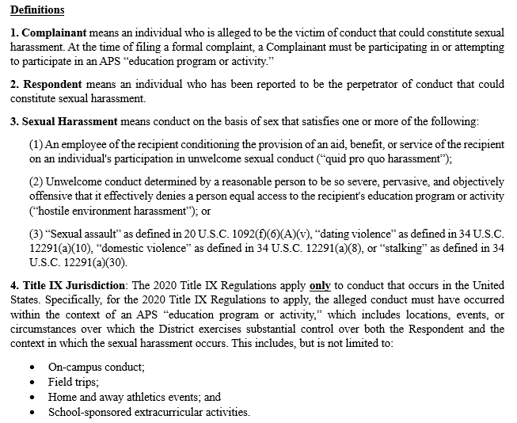

Best Practices for Title IX Decision-Makers

Slide 63
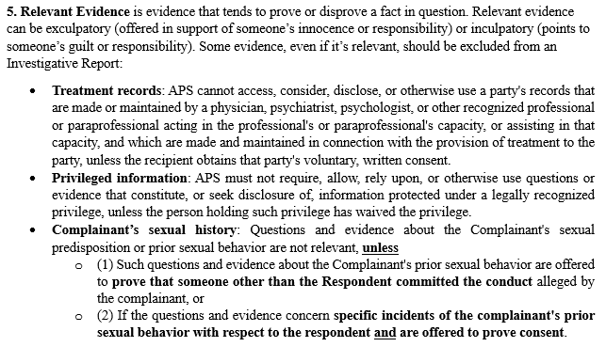

Best Practices for Title IX Decision-Makers

Slide 64
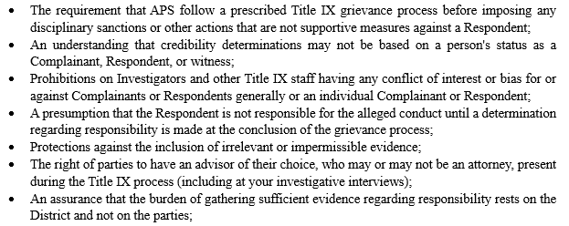
2020 Title IX Regulations: Requirements and Protections

Slide 65
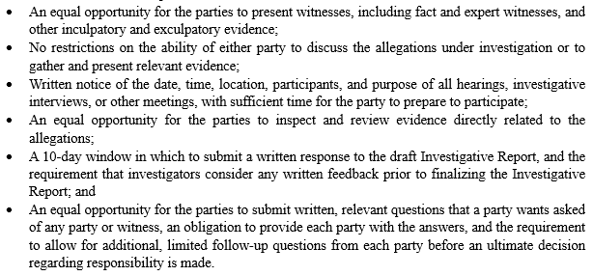
2020 Title IX Regulations: Requirements and Protections

Slide 66
Questions?

